Slide 1
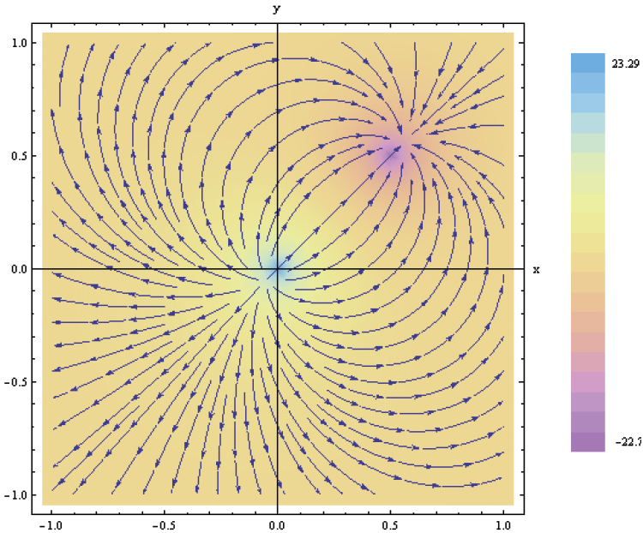
3. Vector Analysis
Applied EM by Ulaby, Michielssen and Ravaioli

Slide 2
Chapter 3 Overview
Basic Vector Operations
Cartesian, Cylindrical and Spherical Coordinates
Gradient
Divergence
Divergence Theorem
Curl
Stokes Theorem
Laplacian Operator

Slide 3
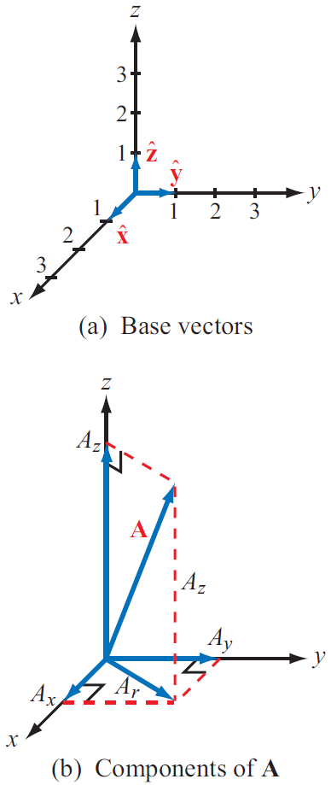
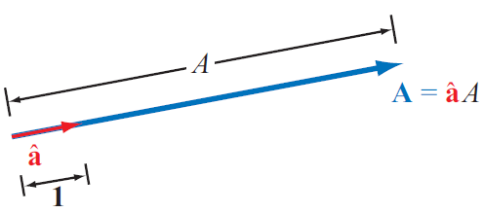
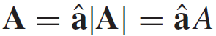
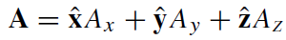
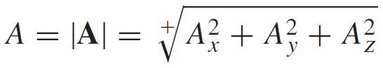
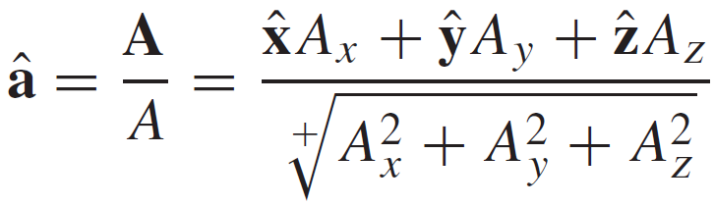
Laws of Vector Algebra

Slide 4
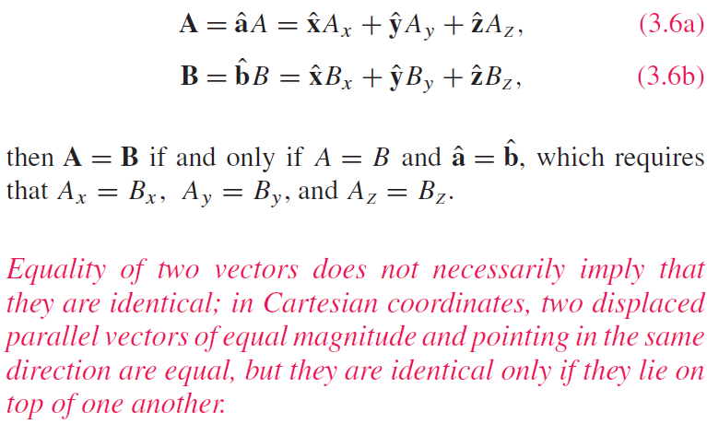
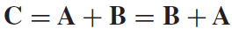
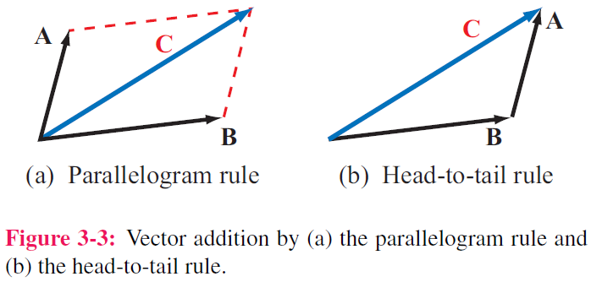
Properties of Vector Operations
Equality of Two Vectors
Commutative property

Slide 5
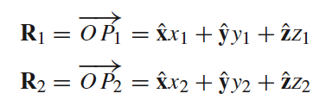
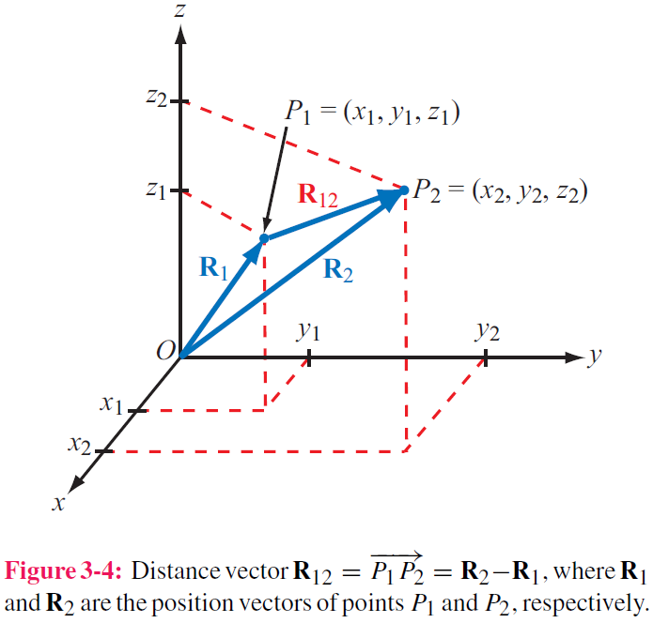
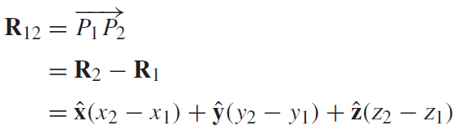

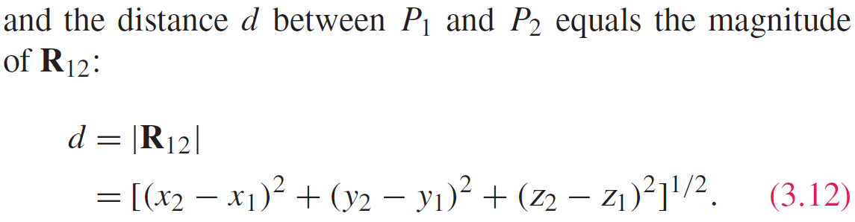
Position & Distance Vectors
Position Vector: From origin to point P
Distance Vector: Between two points

Slide 6
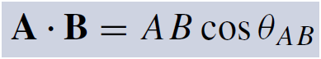
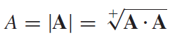
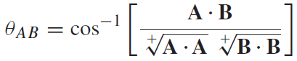
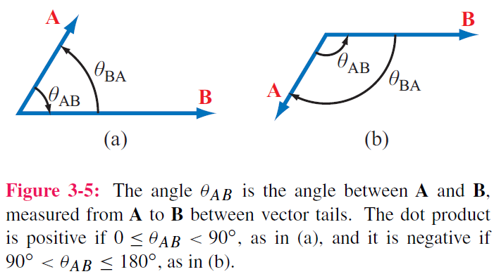
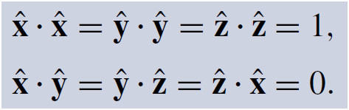
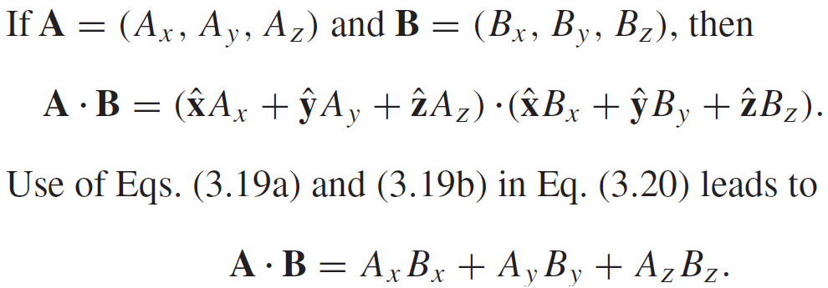
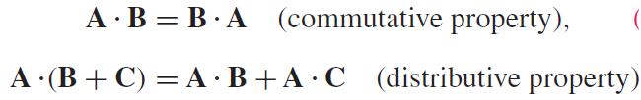

Vector Multiplication: Scalar Product or ”Dot Product”
Hence:

Slide 7
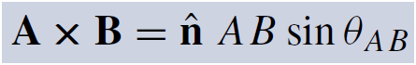
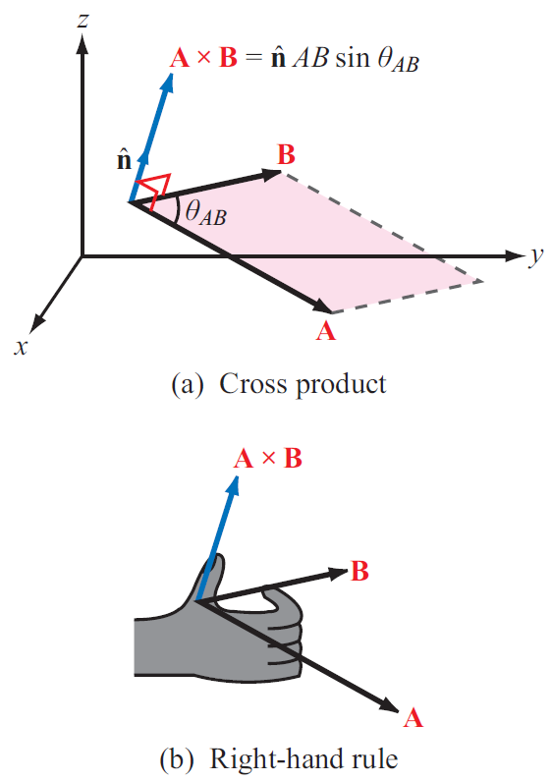
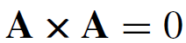
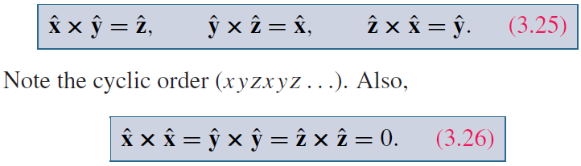
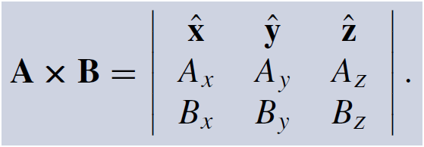
Vector Multiplication: Vector Product or ”Cross Product”

Slide 8
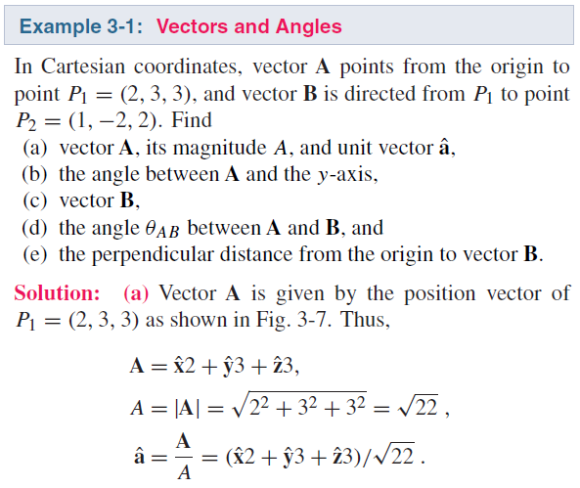
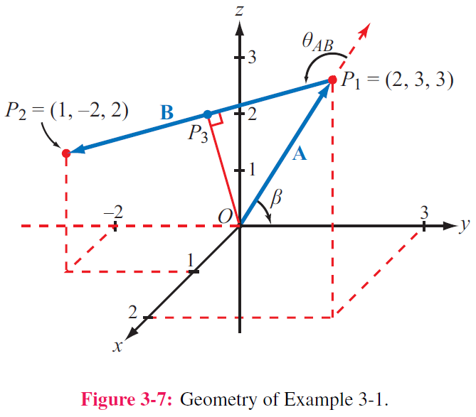

Slide 9
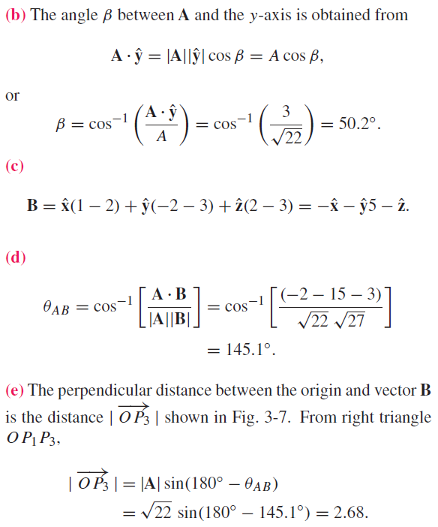

Slide 10
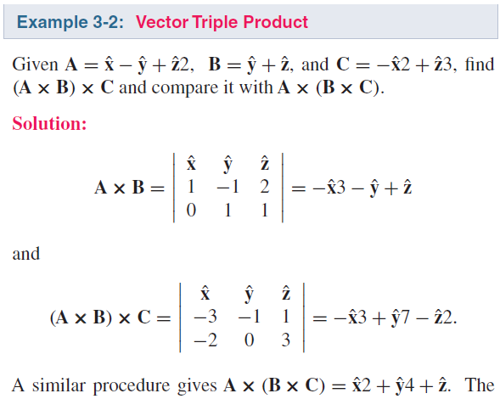
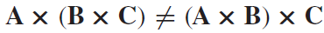

Triple Products
Hence:

Slide 11
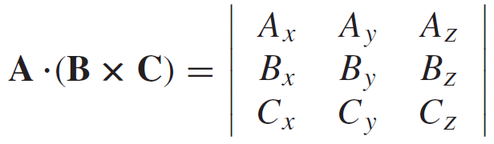
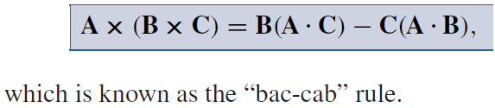
Triple Products
Scalar Triple Product
Vector Triple Product

Slide 12
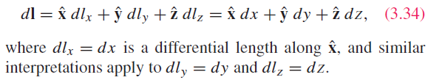
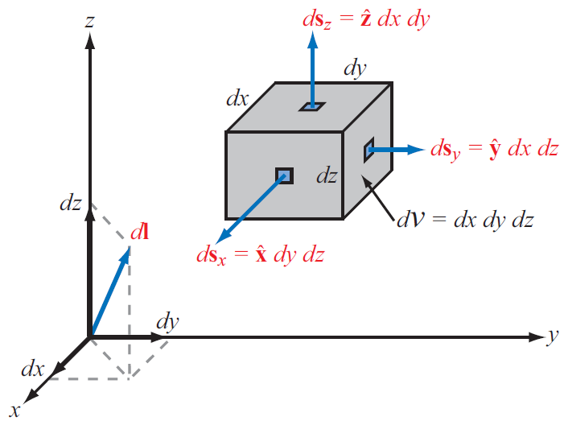
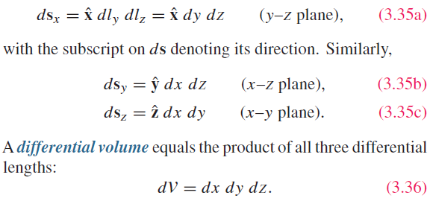
Cartesian Coordinate System
Differential length vector
Differential area vectors

Slide 13
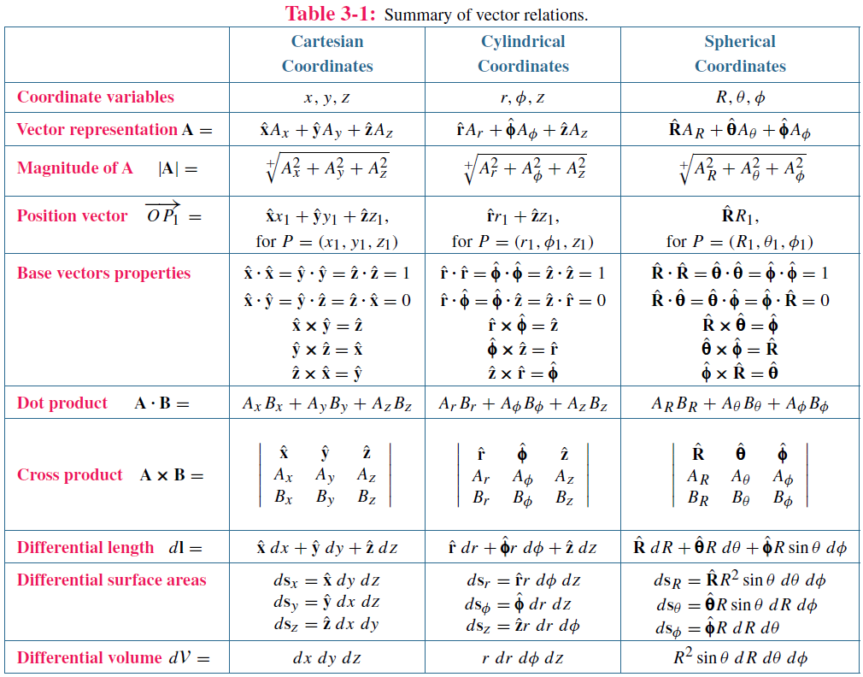

Slide 14
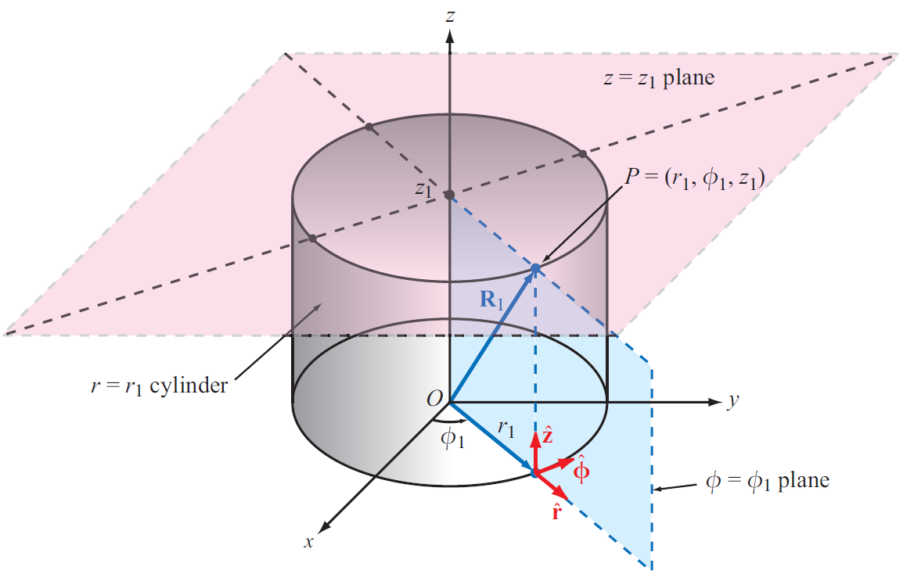
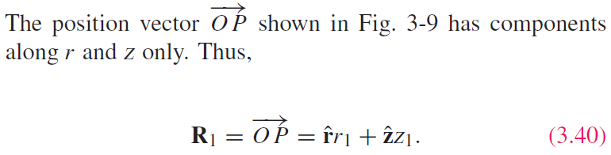
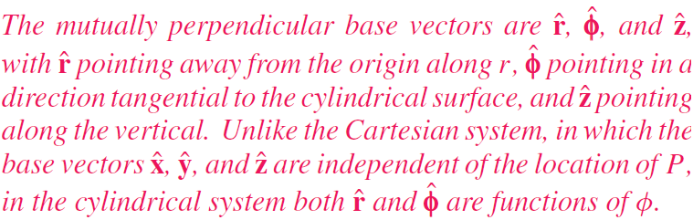
Cylindrical Coordinate System

Slide 15
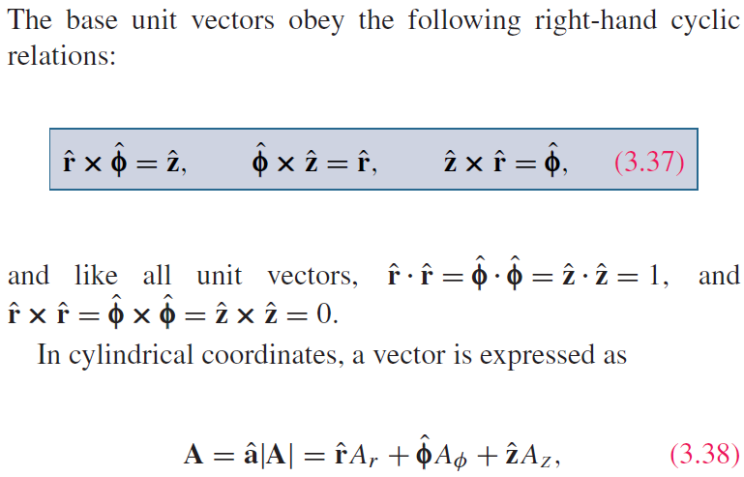
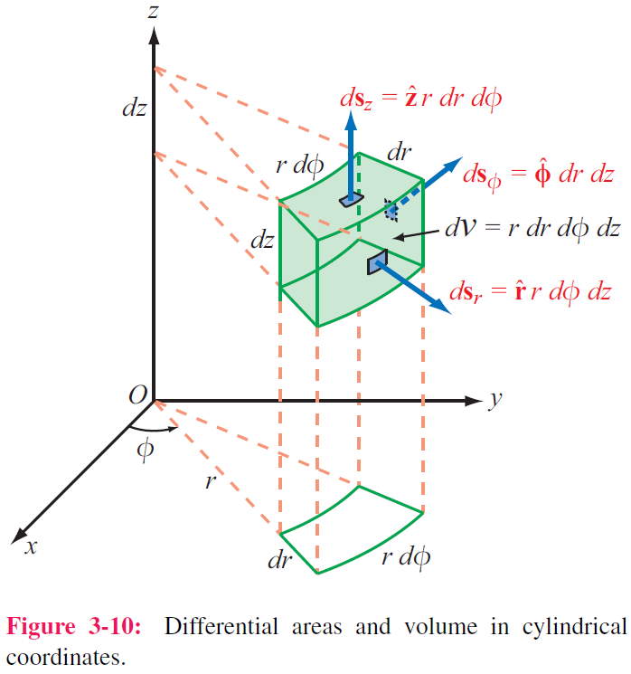
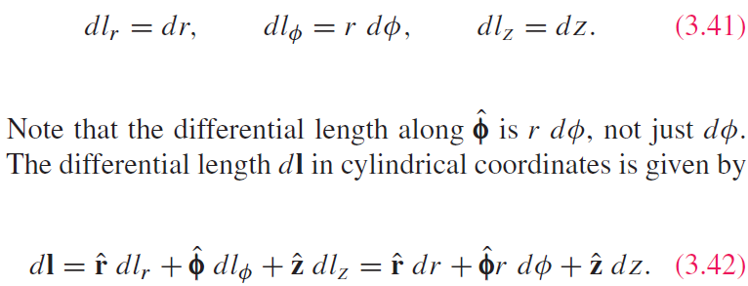
Cylindrical Coordinate System

Slide 16
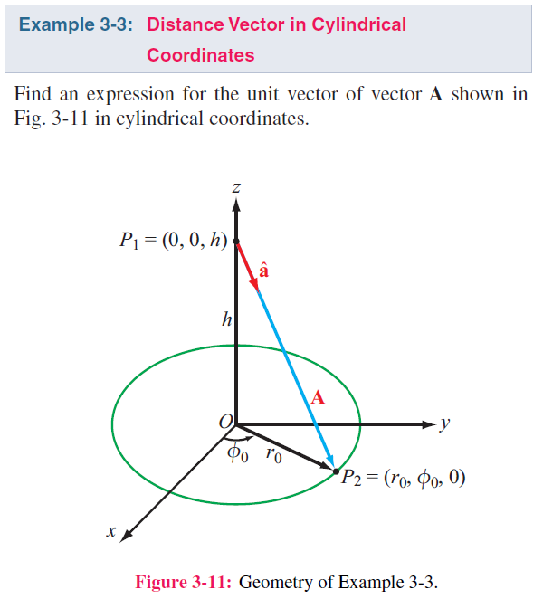
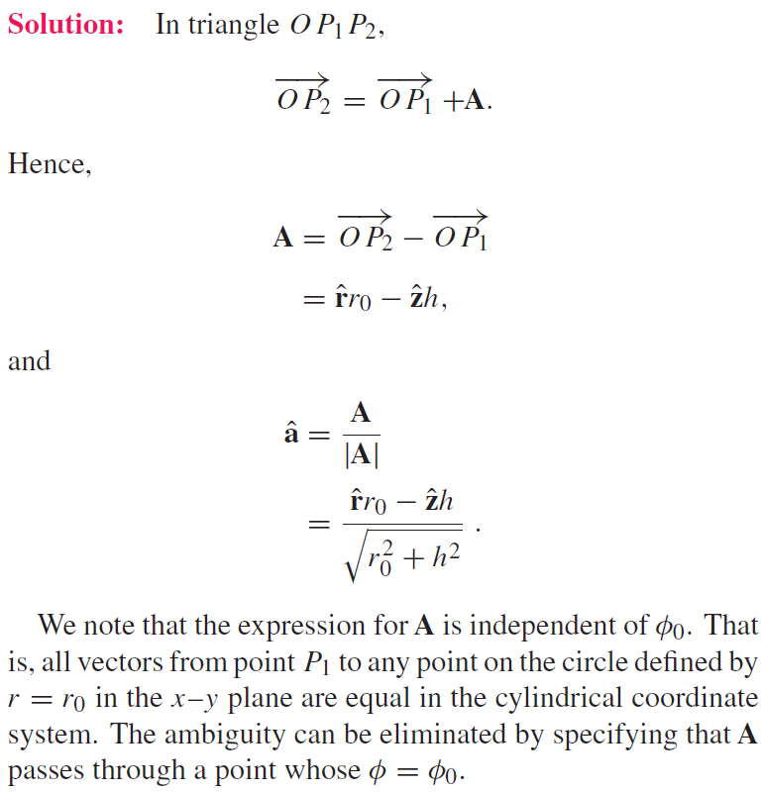

Slide 17
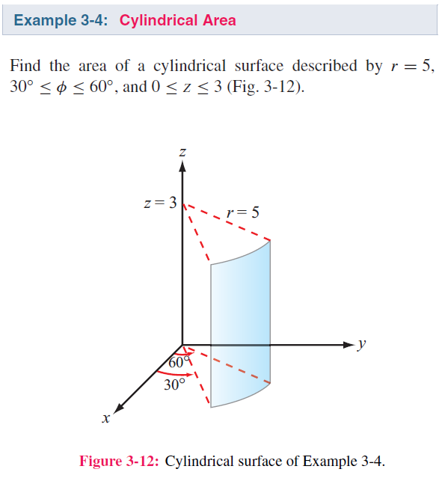

Slide 18
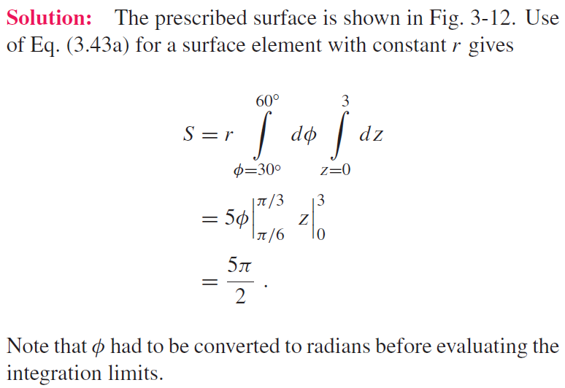

Slide 19
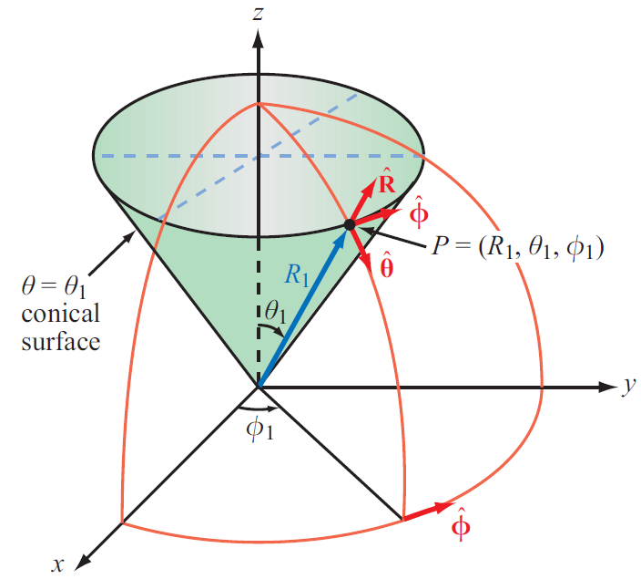
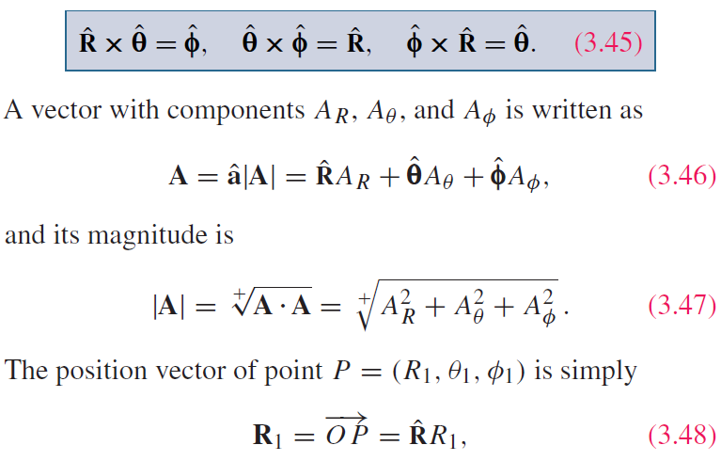
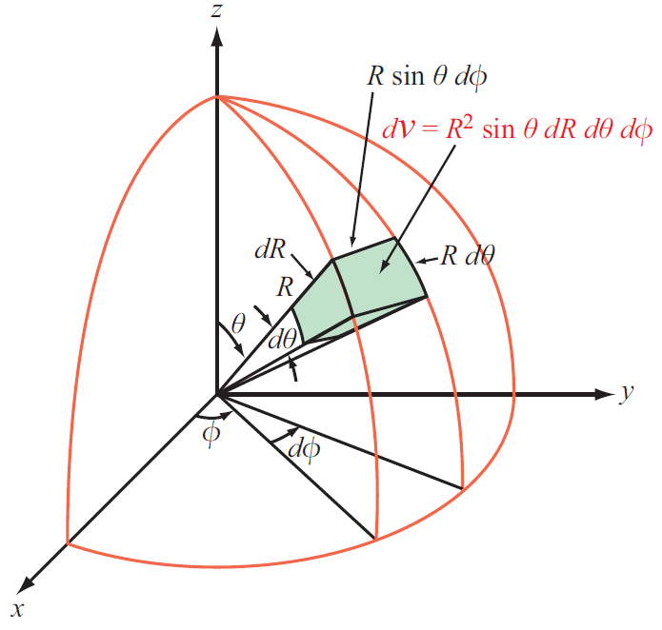
Spherical Coordinate System

Slide 20



Slide 21


Slide 22




Gradient of A Scalar Field

Slide 23

Gradient of A Scalar Field

Slide 24


Gradient ( cont.)

Slide 25

Gradient ( cont.)

Slide 26

Gradient ( cont.)

Slide 27
Gradient ( cont.)

Slide 28



Divergence of a Vector Field

Slide 29


Divergence Theorem
Useful tool for converting integration over a volume to one over the surface enclosing that volume, and vice versa

Slide 30


Slide 31


Slide 32



Curl of a Vector Field

Slide 33




Curl of a Vector Field
$$F\left(x, y, z\right)=y\hat{x}−x\hat{y}$$
$$∇×F=−2\hat{z}$$

Slide 34




Curl of a Vector Field
$$F\left(x, y, z\right)=−x^{2}\hat{y}$$
$$∇×F=−2x\hat{z}$$

Slide 35




Stokes’s Theorem

Slide 36



Laplacian Operator
Laplacian of a Scalar Field
Laplacian of a Vector Field
Useful Relation

Slide 37

Some Useful Vector Identities

